Slide 1
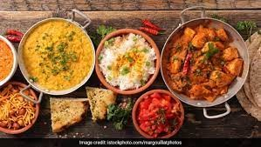

FOOD CONSUMPTION IN INDIA
SANDRINE PREVOT
FEB, 11th | PARIS
DAFT NOV21

Slide 2

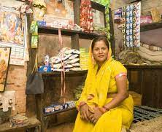
Business case
Domain: Consumer behaviour in India
Analyze the indicators that correspond with quality of life and the responsiveness of demand taking into account that the link with social background permit a better understanding of the consumer.
Keep in mind: there is a political issue: in a context of Hindu nationalism, the religion and casts is used for political purposes in order to divide Indians (the stigmatization is based food consumption)
The objective of the project is to see whether social characteristics determine consumption behavior or not.

Slide 3
Process
About data
Socio-Economic/Monitoring Survey of NSS
Title: India - Household Consumer Expenditure, NSS 68th Round : July 2011 - June 2012
From : National Sample Survey Office - Ministry of Statistics and Programme Implementation(MOSPI),Government of India.
Data Loading
Data cleaning
EDA
Encode non-numeric data
Clusters Investigations
Model Evaluation
Model implementation

Slide 4
Data cleaning and preprocessing
1. Three datasets:
Household: Shape (101662, 45)
Household: Shape (101662, 39)
Food expenditure: Shape (5763152, 35)
2. Build a unique dataset:
Merge on Household ID and features selections: Shape (100497, 33)
7 columns non-numeric – 26 columns numerics
3. Cleaning
Rename labels of columns
Build a new classification with filter creation on food items
Check for duplicates/ missing value
Exclude outliers in each column
Drop rows with small numbers of household (ex: 'Zoroastrianism’, only one household)
Check collinearity

Slide 5
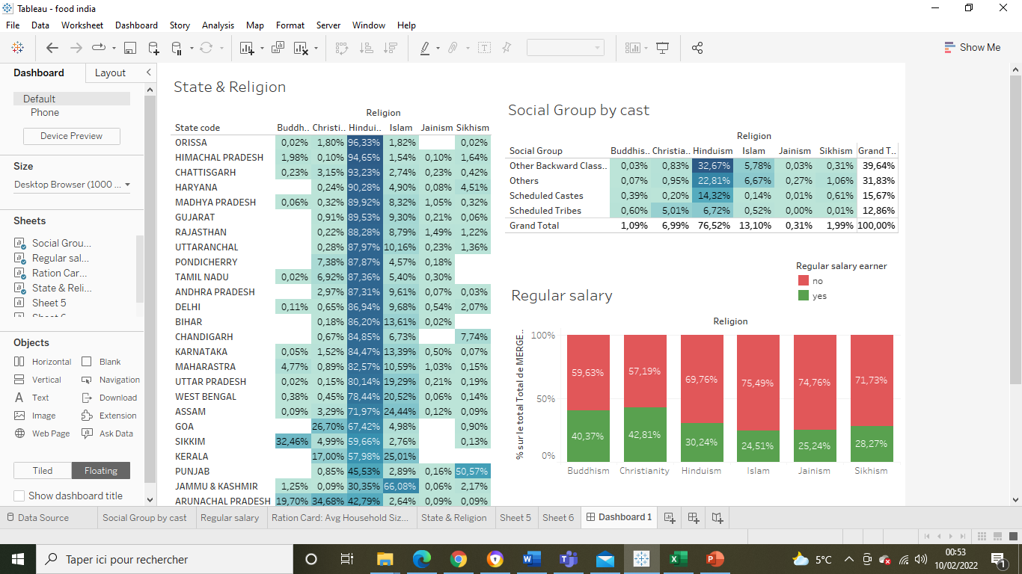
EDA
OBC
Scheduled Castes
Scheduled Tribes
Communauties in theses divisions benefit of the positive discrimation policy
( Quotas in public employment and high School – 50% of places and job)
Others:
Communauties advanced socially and economically

Slide 6
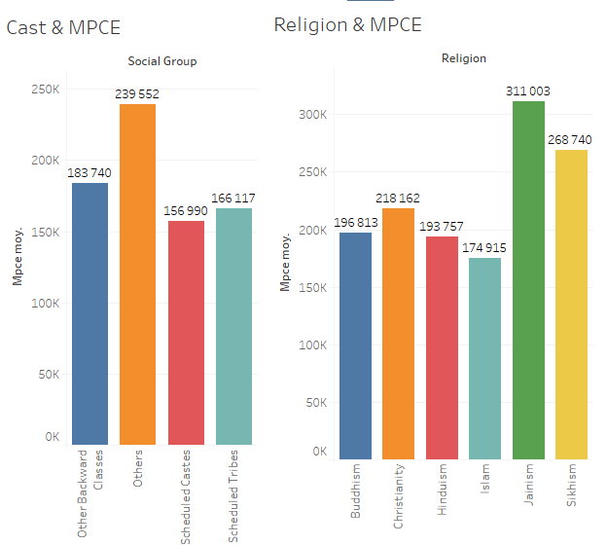
EDA

Slide 7
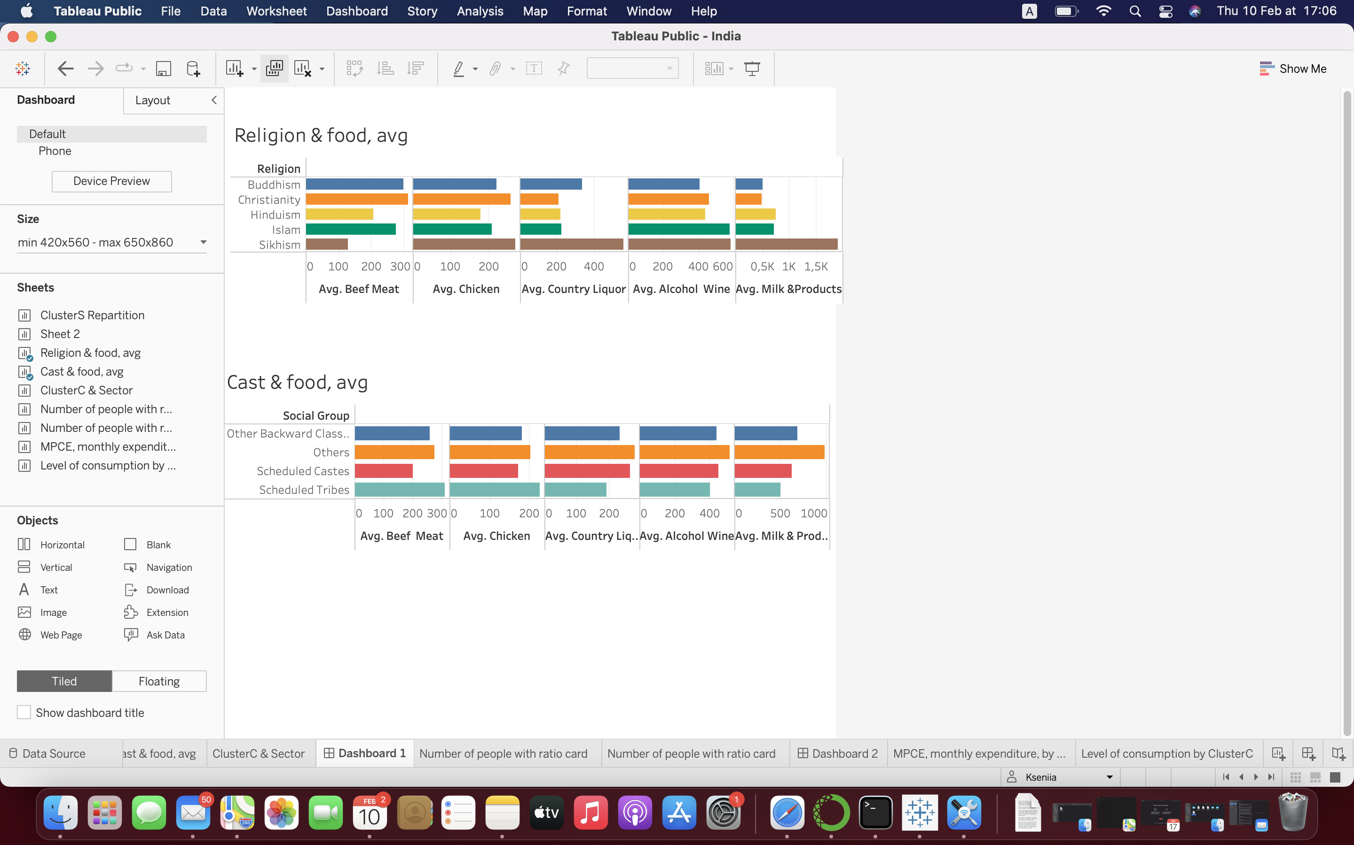
EDA

Slide 8
UNSUPERVIZED MODEL - KMEANS
24 columns to cluster
PCA:
Principal Component Analysis (PCA) is used for dimensionality reduction in machine learning.
PCA is used to filter noisy datasets, such as image compression.
KMEANS: Unsupervised machine learning algorithms
k-means clustering tries to group similar kinds of items in form of clusters. It finds the similarity between the items and groups them into the clusters.
K-means clustering algorithm works in three steps:
Select the k values.
Initialize the centroids.
Select the group and find the average

Slide 9
Models evaluation
Models | Optimum of clusters | Score Silhouette
KMEANS KElbowVisualizer(k = (2,5), metric='silhouette') | 2 | 0,623
AGGLOMERATIVE KElbowVisualizer( k = (2,5), metric='silhouette') | 2 | 0,561
GAUSSIAN (range (2,6)) | 2 | 0.620
DBSCAN (eps in range (1,5)&min_samples in range (2,5)) | 2 ( or 68) | -0.170 ( or -0.939)

Slide 10
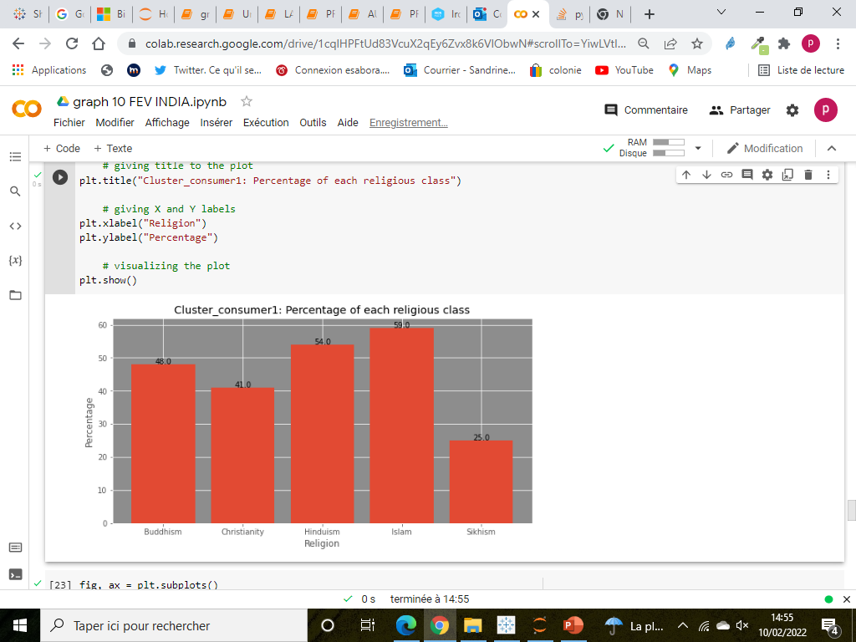
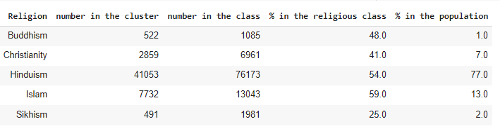
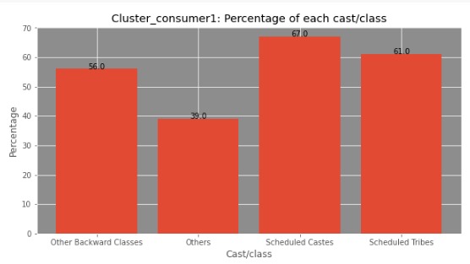
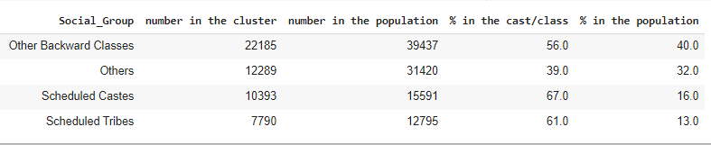
Main results
Cluster 1: More Musulman (59% of musulman are in cluster1); more Scheduled Castes & Tribes (67% and 61% respectively)

Slide 11
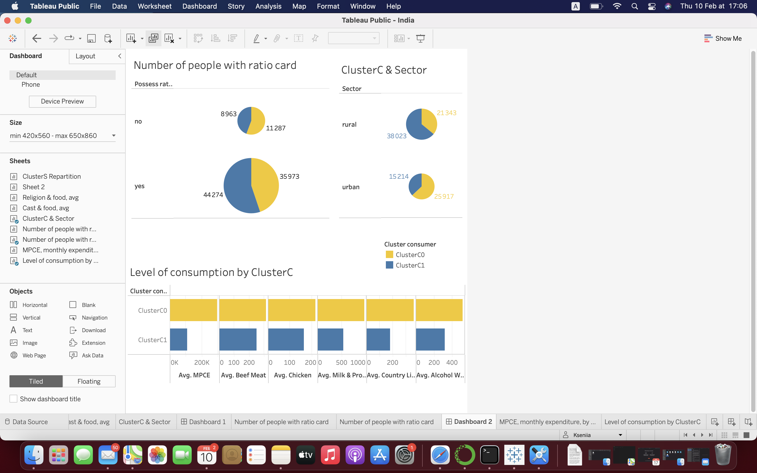
Main results
Cluster1: less money, less food,
More rural, with ratio card

Slide 12
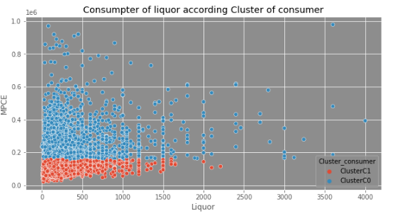
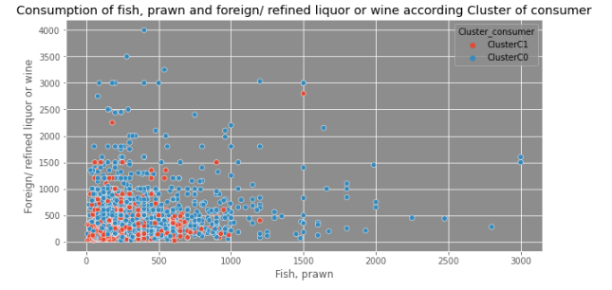
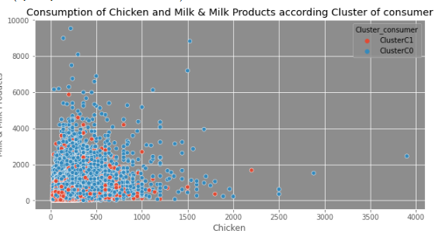
Main results
The main difference seems to be based on level of revenue.
The one who is poor and eats less is from scheduled caste, Tribes and Islam, and lives more in rural sector
There is no difference of the structure of food consumption related to the cast or religion values ( when they have the same level of expenditure, the consumption is the same)

Slide 13
FOOD CONSUMPTION IN INDIA
SANDRINE PREVOT
Q&A?

